Slide 1
Programming Fundamentals
By
Shazmeen Batool

Slide 2
Lab Task 1
Write a C++ program that takes data in 2’D array based on the number of rows and columns entered by user.

Slide 3
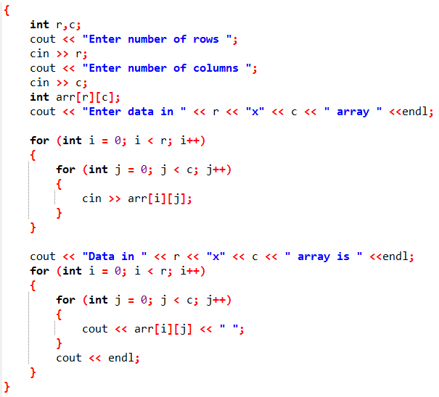

Slide 4
Lab Task 2
Write a C++ program to declare a 2D array which can store marks of 3 subjects of 5 students.

Slide 5
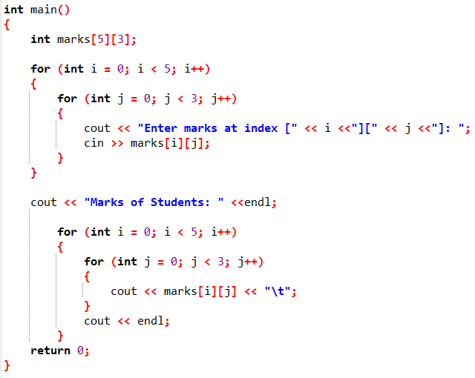
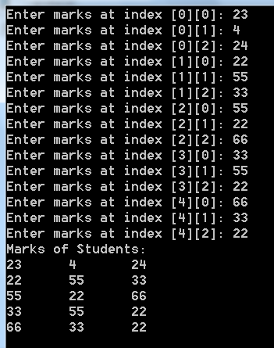

Slide 6
Lab Task 3
Write a C++ program that add two 2’D Arrays.

Slide 7
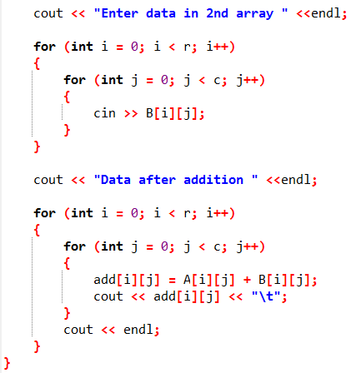
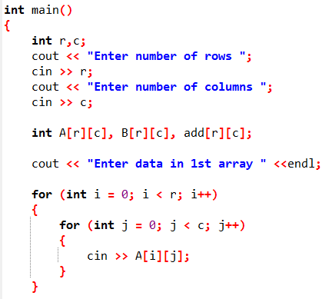

Slide 8
Lab Task 4
Write a C++ program that performs subtraction on two 2’D Arrays.

Slide 9
Lab Task 5
Write a C++ program to generate the sum of left diagonal.

Slide 10
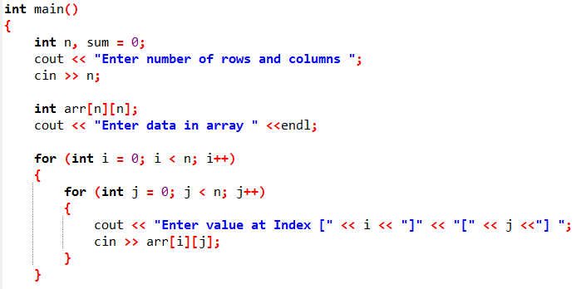
Part 1/2

Slide 11
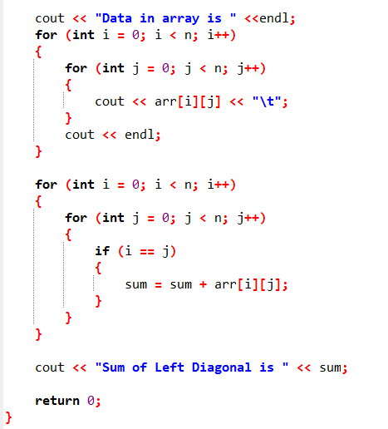
Part 2/2

Slide 12
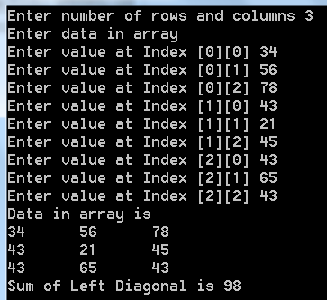
Output

Slide 13
Lab Task 6
Write a C++ program to generate the sum of right diagonal.

Slide 14
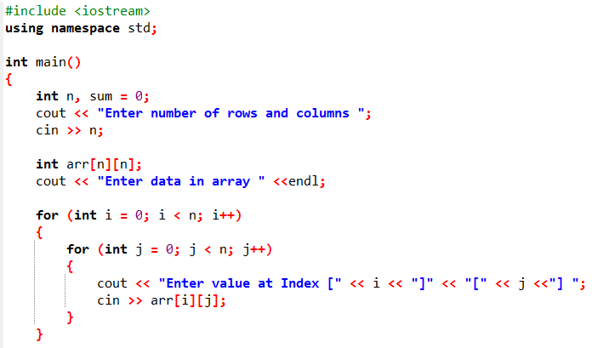
Part 1/2

Slide 15
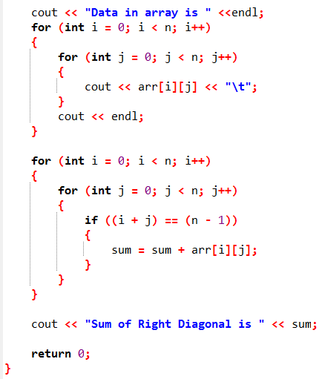
Part 2/2

Slide 16
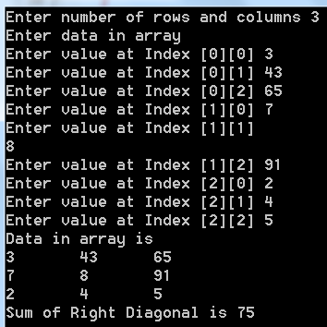
Output

Slide 17
Lab Task 7
Write a C++ program to generate transpose of matrix.

Slide 18
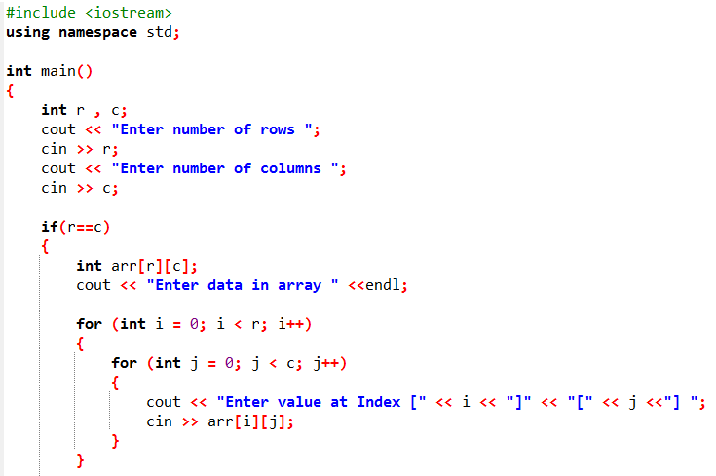
Part 1/2

Slide 19
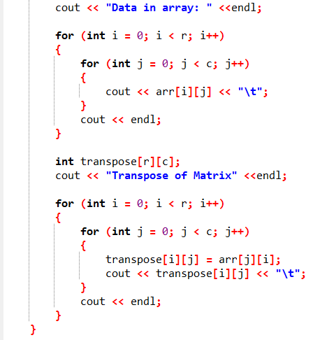
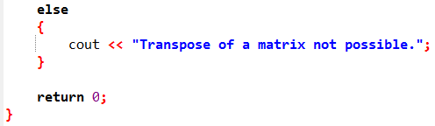
Part 2/2

Slide 20
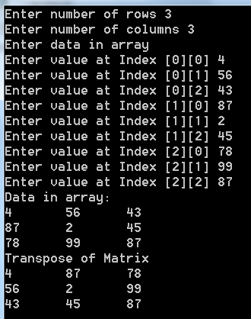
Output

